Slide 1
Workshop
Single-cell/nuclei RNA sequencing analysis with scFlow
Combiz Khozoie, Nurun Fancy
Alan Murphy, Eugene Duff
Imperial College London
4/08/22
Slides: https://tinyurl.com/y92hr3pz

Slide 2
Goal: Provide a general overview of single-cell analysis and hands-on practical experience of analysing a real-world dataset using scFlow
10:00-10:10 Introduction to the workshop (ED)
10:10 - 10:45 Introduction to single-cell RNA sequencing and scFlow (CK)
10:45-11:30 Quality control with scFlow (CK)
11:30-12:30 Integration and Dimensionality reduction (NF/CK)
12:30-13:15 Lunch4
13:15-14:00 Clustering and cell-typing (CK/AM)
14:00-14:45 Differential gene expression (AM)
14:45-15:00 Break
15:00-15:30 Impacted pathway analysis and Dirichlet modeling (NF)
15:30-16:00 HCP / Private Cloud / Nextflow / Future developments and Questions

Slide 3
Single-cell RNA-sequencing

Slide 4
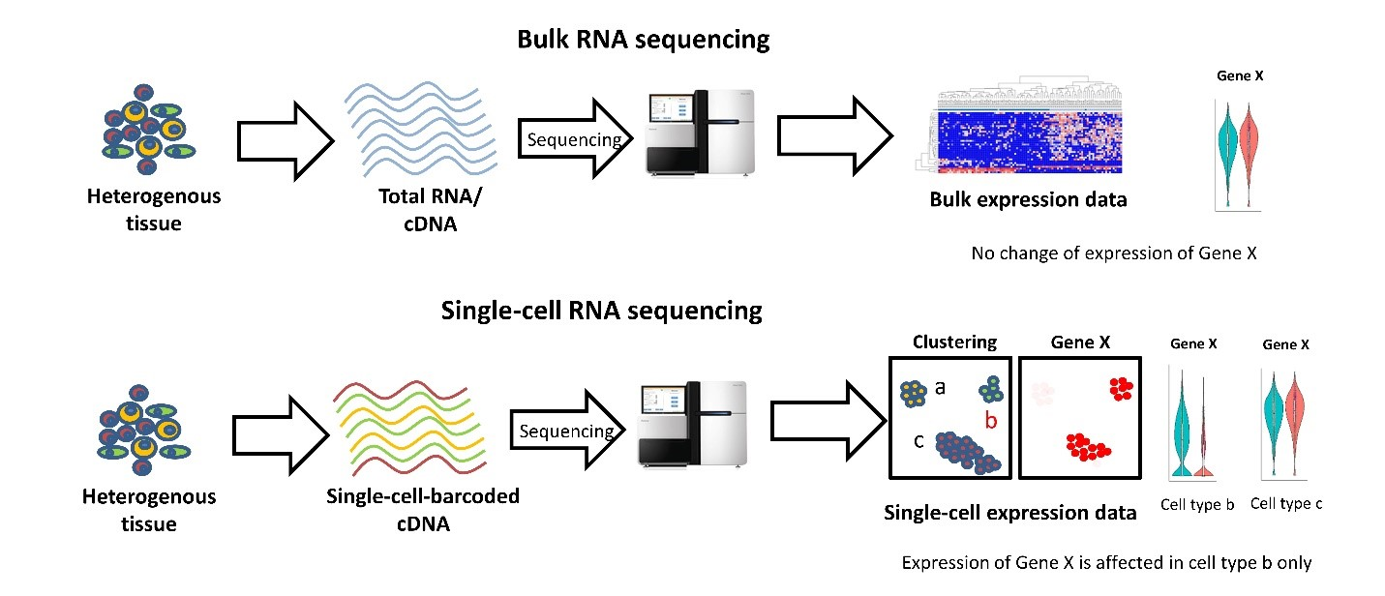
Why single-cell RNA sequencing?
Single-cell RNA sequencing (scRNA-seq) enables transcriptomic profiling at single-cell resolution, providing unprecedented insight into gene expression within cell populations.
Recent Advances in Single-cell Genomics Techniques, Dmitry Velmeshev, 2019

Slide 6
From bulk RNA-seq to single-cell RNAseq
RNA-seq is typically performed in "bulk"
The data represent an average of gene expression patterns across thousands to millions of cells
This might obscure biologically relevant differences between cells
Single-cell RNA-seq (scRNA-seq) represents an approach to overcome this problem
Isolate single cells -> capture their transcripts -> generate sequencing libraries in which the transcripts are mapped to individual cells

Slide 7
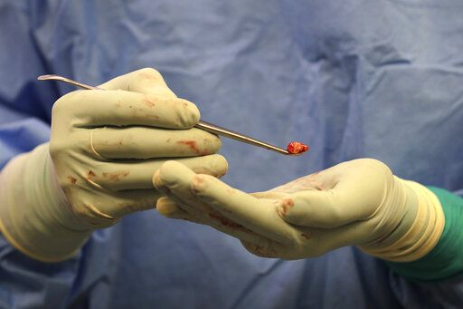
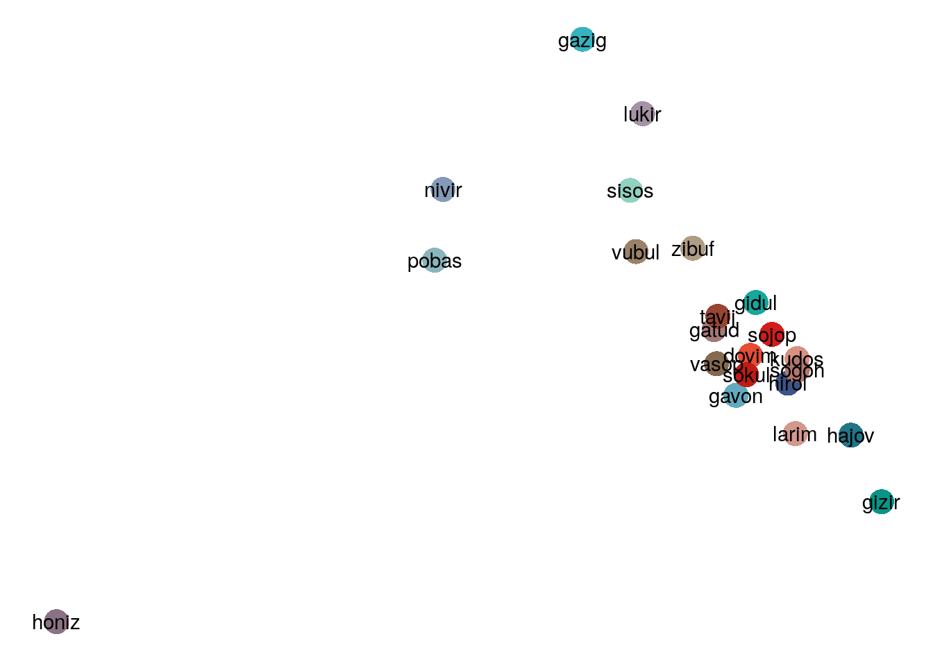
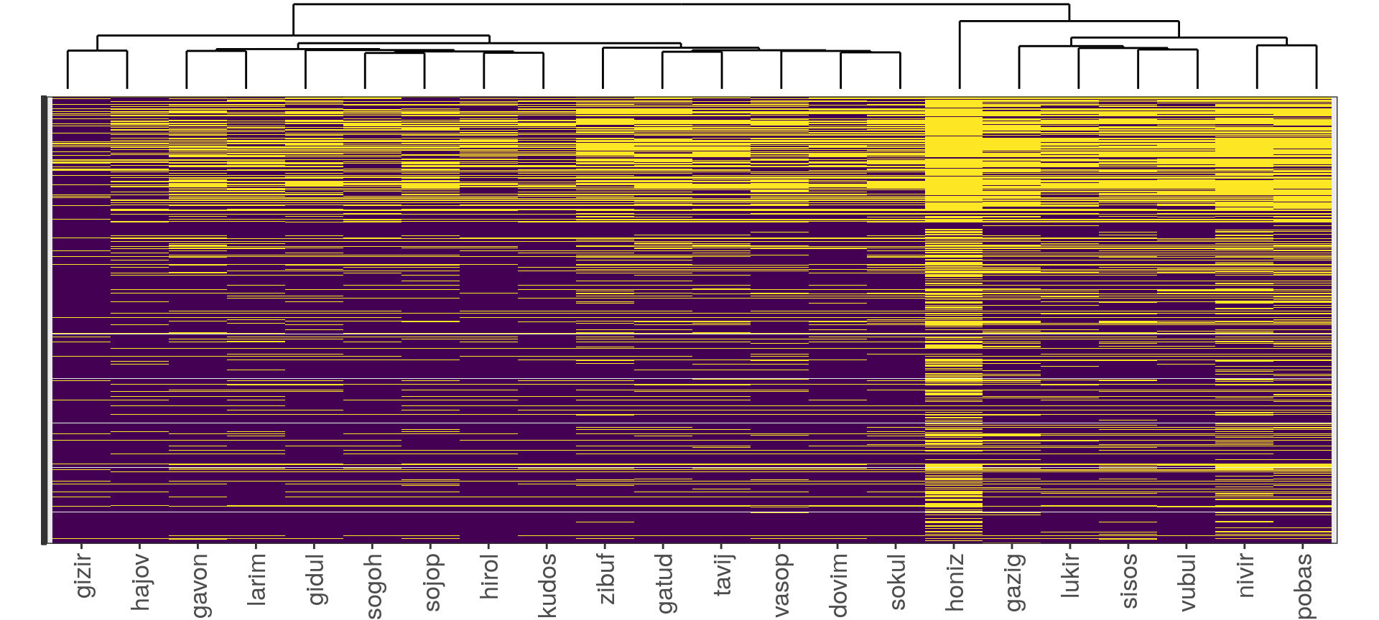
Example Study: Multiple sclerosis ~22 samples (bulk)
Genes
Samples

Slide 8
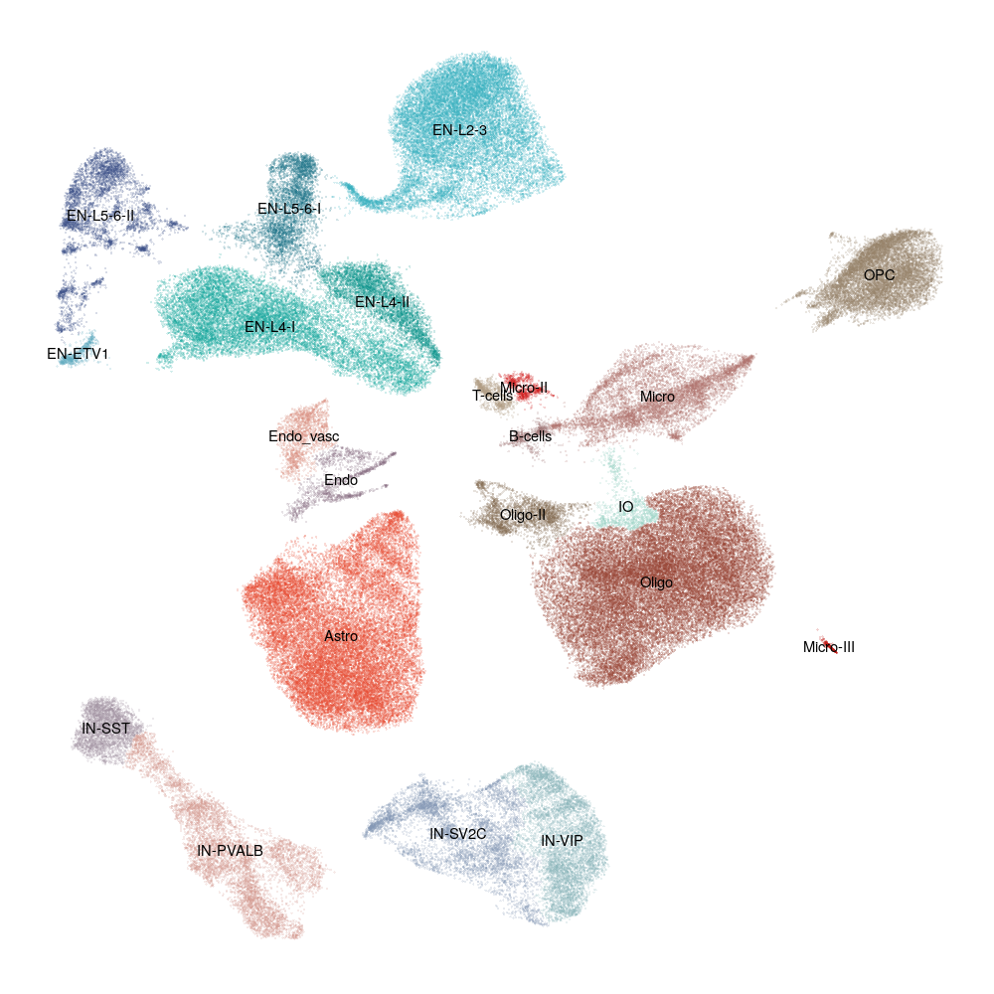
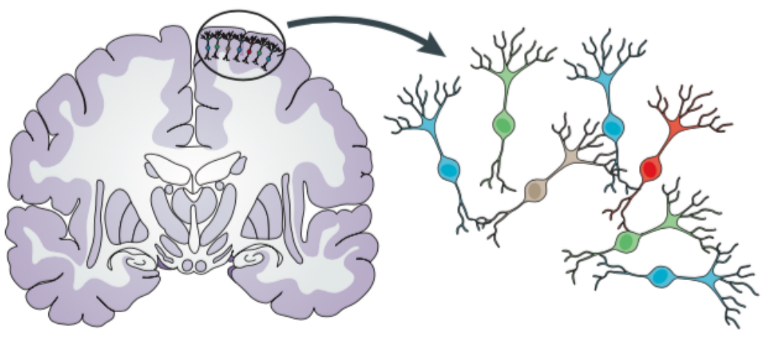
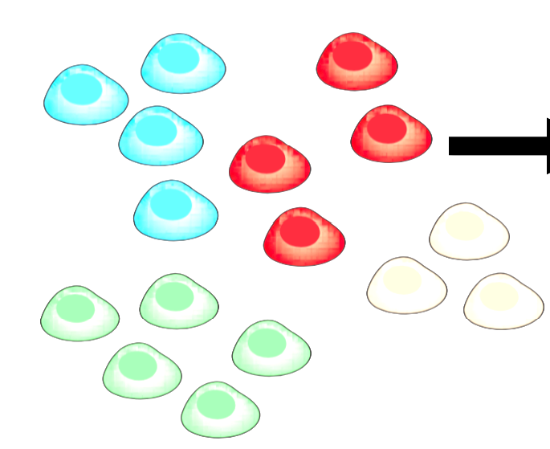
Example Study: Multiple sclerosis ~22 samples (single-cell)
Genes
Cells

Slide 9
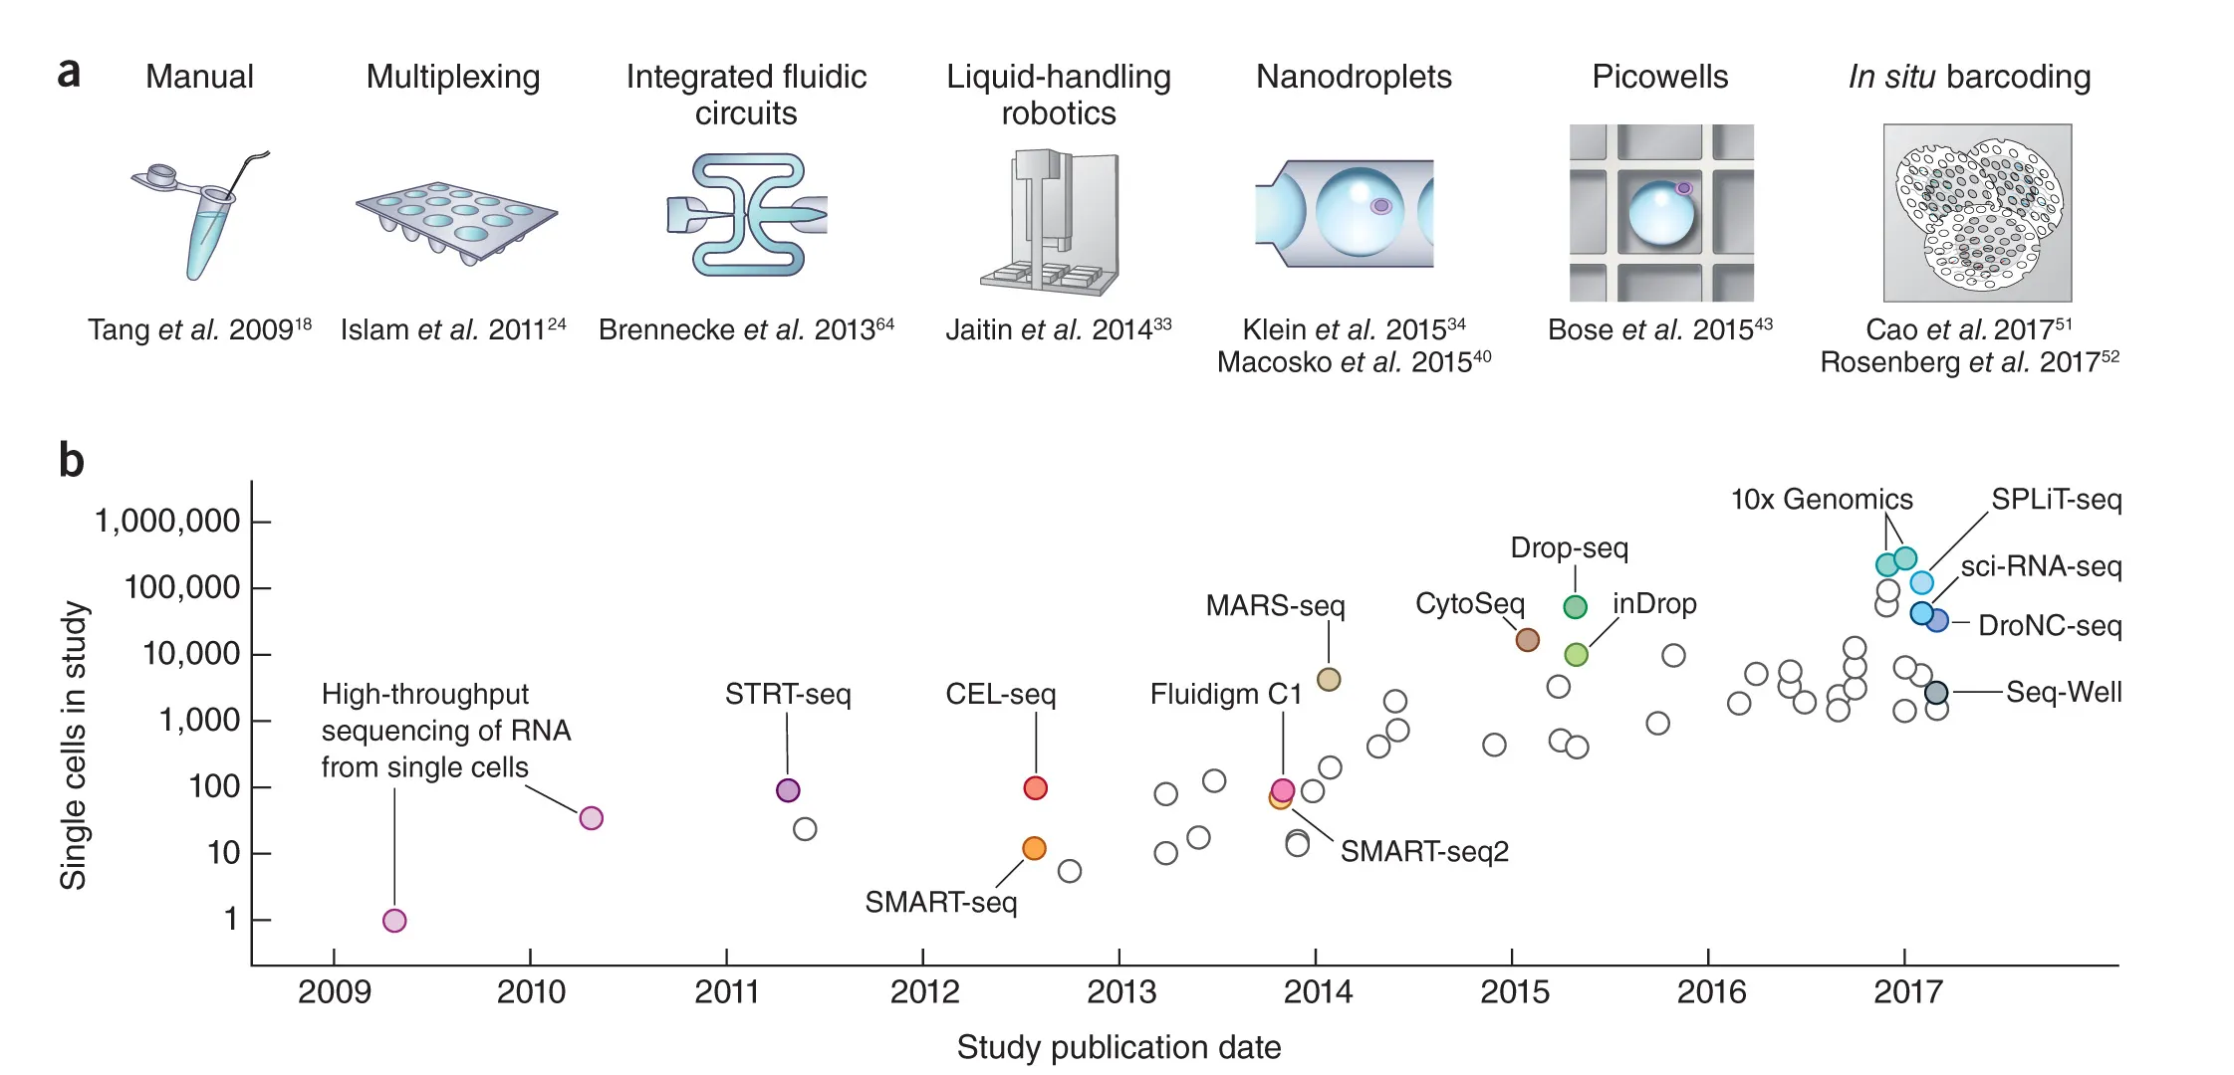
Exponential scaling of single-cell RNAseq in the last decade
Svensson V et al. (2018) Exponential scaling of single-cell RNA-seq in the past decade. Nature Protocols 13: 599–604. DOI: 10.1038/nprot.2017.149.

Slide 10
Exponential scaling of single-cell RNAseq in the last decade
Droplet microfluidics has enabled a massive increase in throughput and reduction in cost
Enables the high-throughput generation of water-in-oil droplets.
Co-encapsulation of cells with barcode-containing microbeads enables labelling of all the RNA from each cell with a unique barcode, such that after pooling and sequencing, each read can be mapped back to its cell-of-origin.
Image courtesy of Patrick Stumpf, Matthew Rose-Zerilli, Rosanna Smith, Martin Fischlechner & Jonathan West at the Centre for Hybrid Biodevices & Cancer Sciences Unit at the University of Southampton

Slide 11
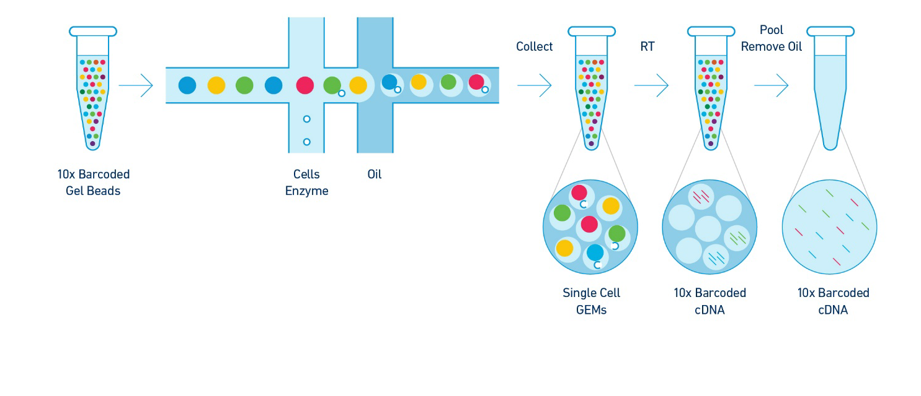
10X Genomics Biochemistry Overview
GEMs (Gel Beads in Emulsion) are reaction vesicles formed on a microfluidic chip and contain single cells, reverse transcription (RT) reagents, barcoded oligonucleotides, and oil.

Slide 12
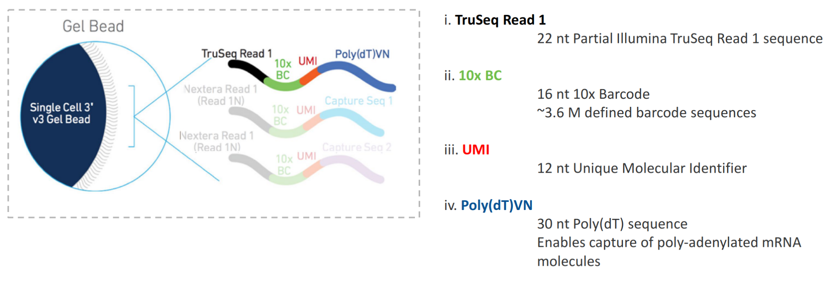
10X Genomics Gel Bead Oligonucleotides

Slide 13
Demultiplexing: using barcode information to assign sequences to individual cells and samples
Cellranger Pipeline
Macosko et al., 2015 (https://doi.org/10.1016/j.cell.2015.05.002)

Slide 14
Characteristics of single-cell/nuclei RNA sequencing data
Data is large, typically hundreds of thousands of cells for a case-control study (e.g. 300000 cells x 20000 genes = 6 billion data points).
Need more memory/RAM, more CPU cores, typically need HPC / Cloud.
Data is sparse.
Individual cells show zero counts for many genes. This can be due to: (1) cells genuinely not expressing a given gene, or (2) relatively low sequencing coverage (typically detect only 10-50% of the transcriptome per cell).
Data is highly variable.
Biological: e.g. cellular processes (e.g. cell-cycle), spatial/microenvironment/signaling, transcriptional bursting (temporal probability), continuous vs discrete cell identities.
Technical: RNA degradation, free floating RNA, amplification bias (not all transcripts amplified equally during library preparation), cell-specific capture efficiency (different number of transcripts captured), batch effects. (e.g. https://doi.org/10.1093/biostatistics/kxx053)

Slide 15
What is scFlow?

Slide 16
The need for a single-cell analysis pipeline
Consolidate experience into a standardized, automated, flexible pipeline
Improve reproducibility with version control and containerization with Docker/Singularity
Accelerate analyses with efficient parallelization and deployment on the HPC and Cloud (e.g. GCP, AWS)
Improve transparency of analysis parameters
Facilitate parameter optimization with caching
Produce an accessible toolkit with a higher level of abstraction

Slide 17
Overview of the scFlow toolkit / pipeline
scFlow R package standalone package built from the ground up for scalable and reproducible workflows |  | nf-core-scflow NextFlow workflow Deploy scalable, reproducible, computationally efficient analyses with scFlow
scflow-docker -- a version controlled docker/singularity image with pre-installed tools for reproducible analyses at scale

Slide 19
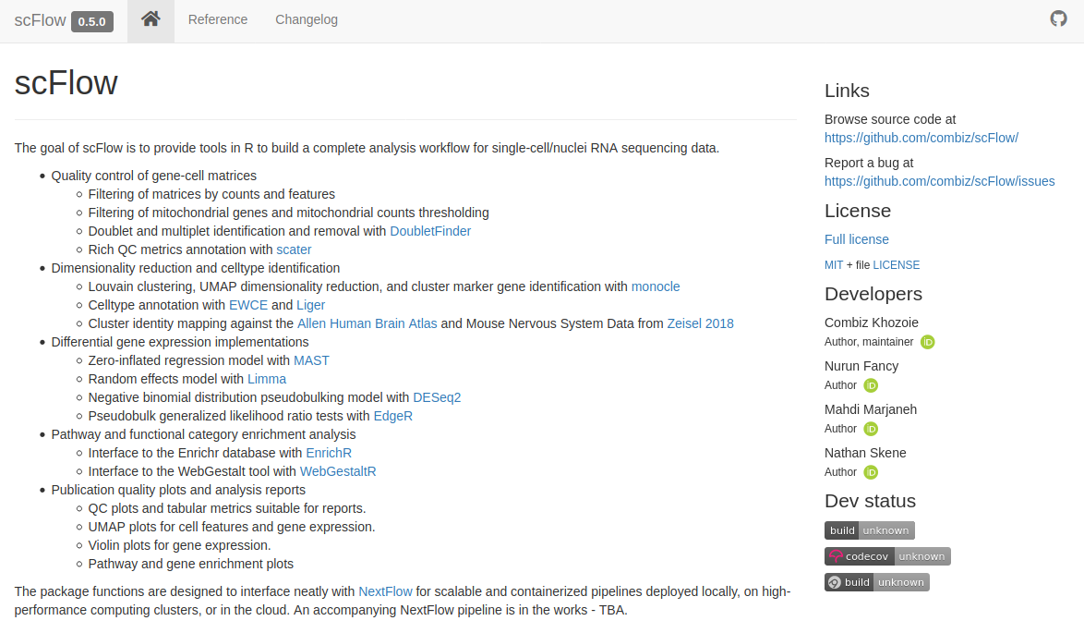
scFlow is an open-source R package (MIT License)

Slide 20
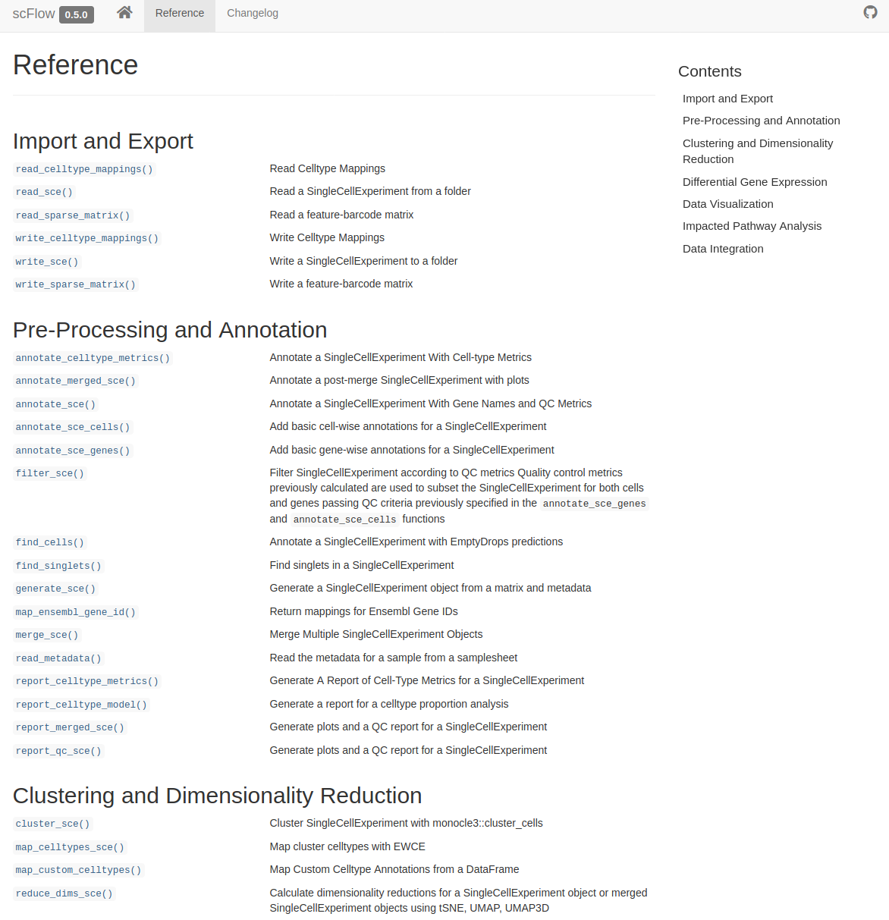
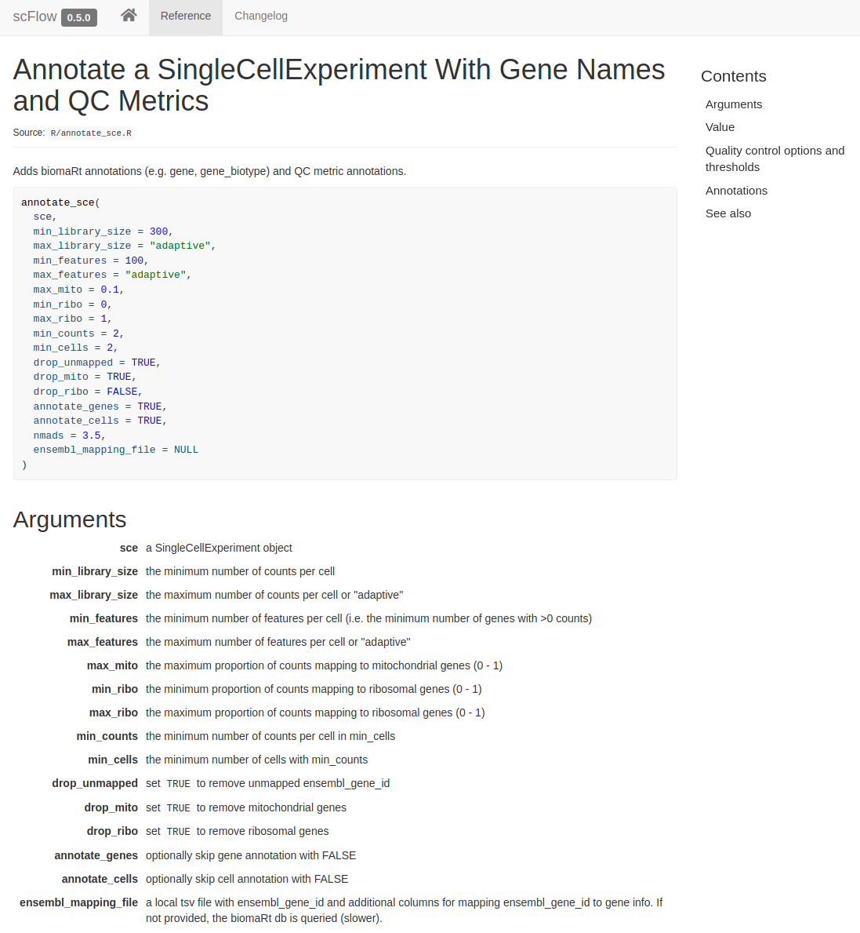
Functions are documented and vignettes are available

Slide 21
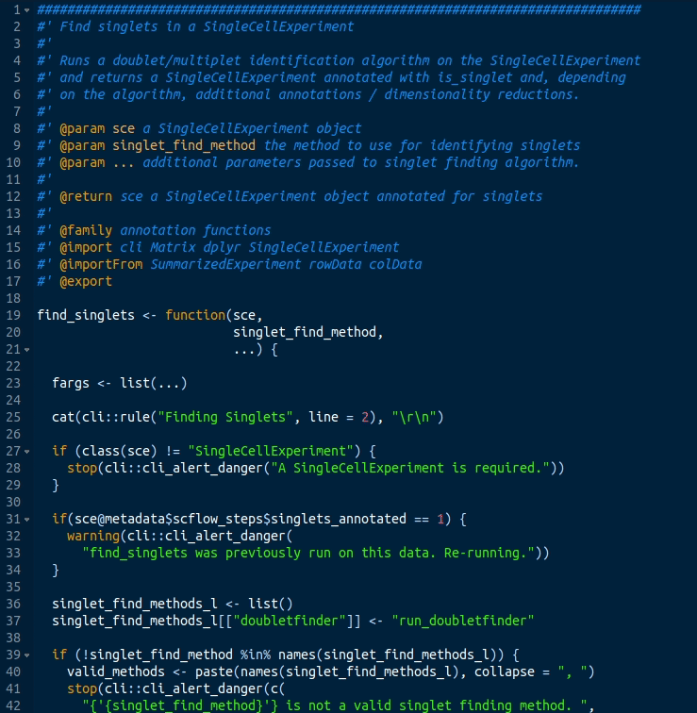
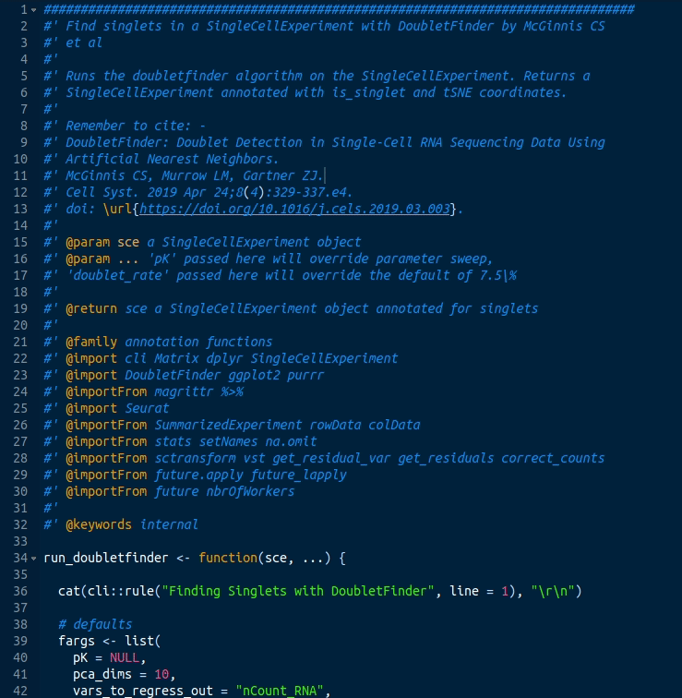
Abstracting away complexity (e.g. identifying doublets)
Before: ~450 lines of code
After: sce <- find_singlets(sce)

Slide 22
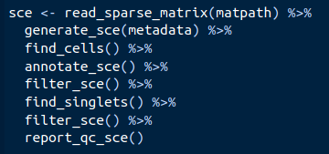
Quality-control with eight lines of code in ten minutes

Slide 23
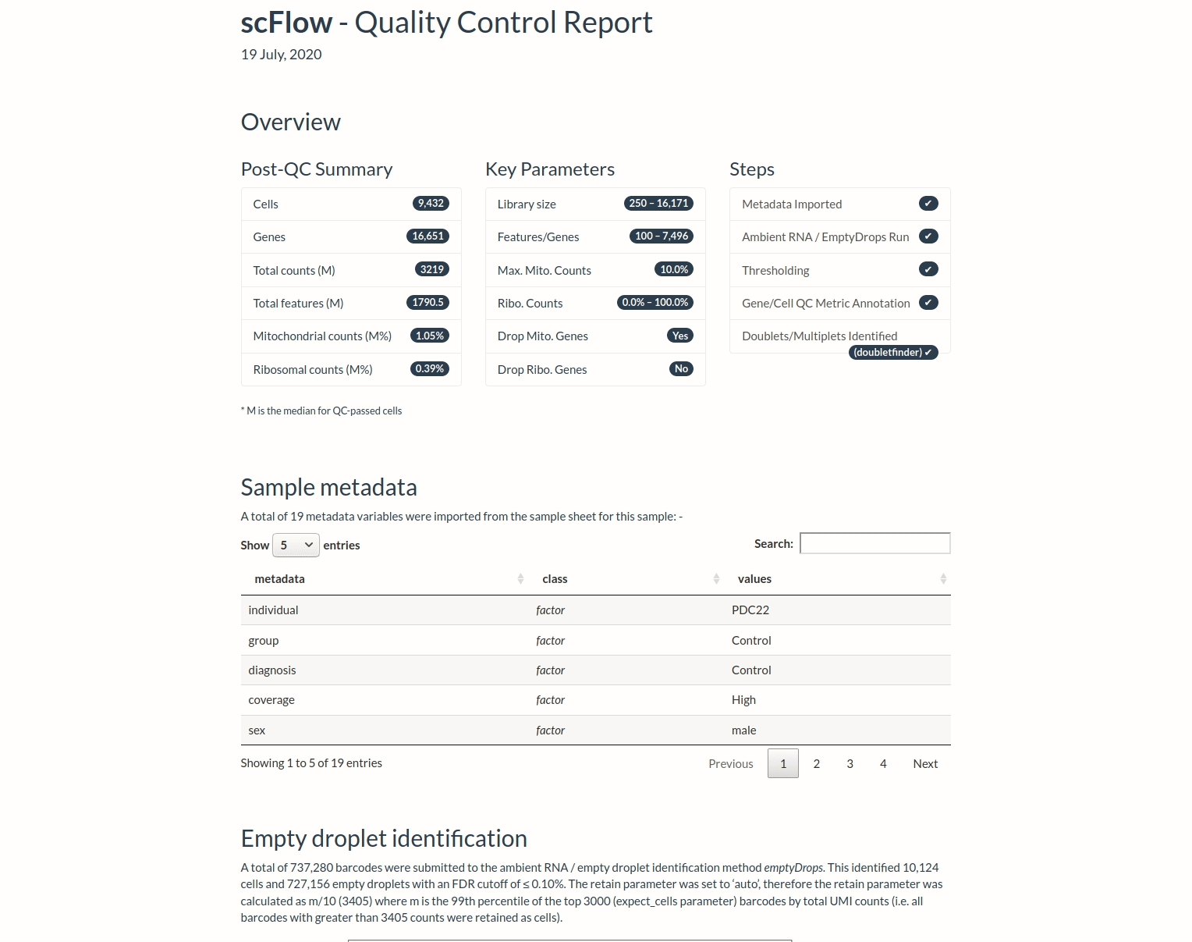
Example QC report
Provides an overview of QC and the effect of parameters
Helps to sense check and optimize thresholds
Key plots and performance metrics for each step e.g. emptyDrops, DoubletFinder, thresholding, etc.

Slide 24
scFlow resources
scFlow R package: https://github.com/combiz/scflow
NextFlow scFlow pipeline:
https://nf-co.re/scflow
https://github.com/combiz/nf-core-scflow (dev)
TERRA/WDL Pipeline (in development):
https://dockstore.org/my-workflows/github.com/eduff/wdl-scflow

Slide 25
Workshop
Complete a full end-to-end case/control analysis of 22 single-nuclei samples (10x) generated from post-mortem brain tissue
Same data as our upcoming manuscript, subset to 15% for speed
Pre-configured cloud based analysis workstation (16 cores / 48 Gb RAM) running the latest version of our scFlow Docker image
You will be given a IP address for a workstation on our Private Cloud. On a browser, go to : <IP>:8900 for access to the R Studio session
Login: scflow
Password: workshop
Practical scripts are in: ~/Documents/workshopscflow/bin
Analysis outputs and reports go to: ~/
These slides: https://tinyurl.com/y92hr3pz

Slide 26
Quality Control

Slide 27
Overview of QC with scFlow
Two main QC steps: within sample (a) and between sample (b)
QC is an important issue
Impacts key analysis outputs (e.g. cell cluster composition, differential gene expression results)
Identification of common genes/pathways between studies (e.g. Wageningen et al., 2021 *)
* Wageningen TA van, E Gerrits, I Bonson S Palacin, I Huitinga, BJL Eggen, Dam AM van. Exploring reported genes of microglia RNA-sequencing data: Uses and considerations.. Glia 69, 2933-2946 (2021).

Slide 28
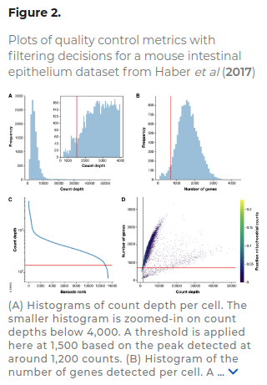
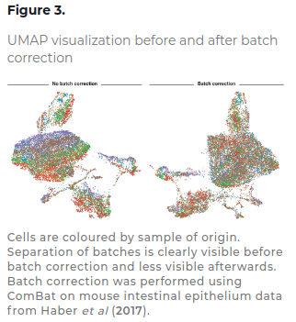

Slide 29
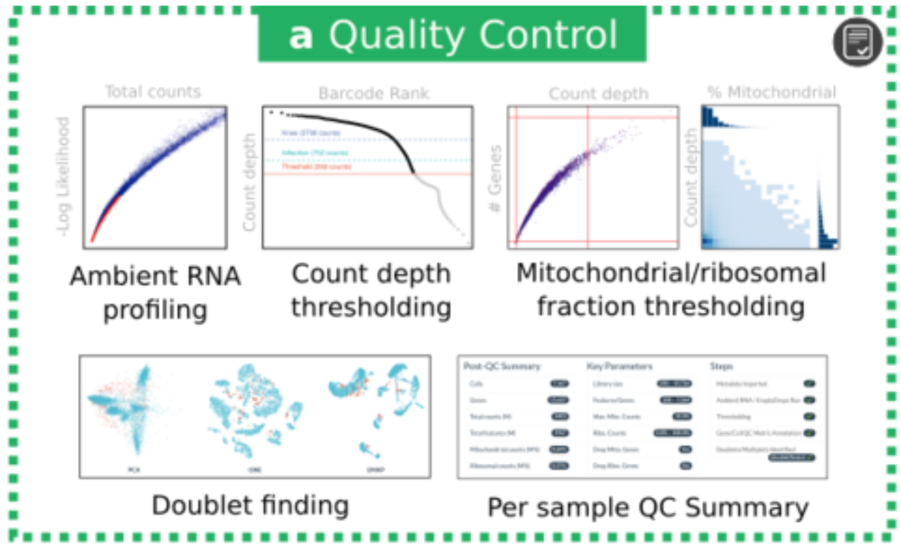
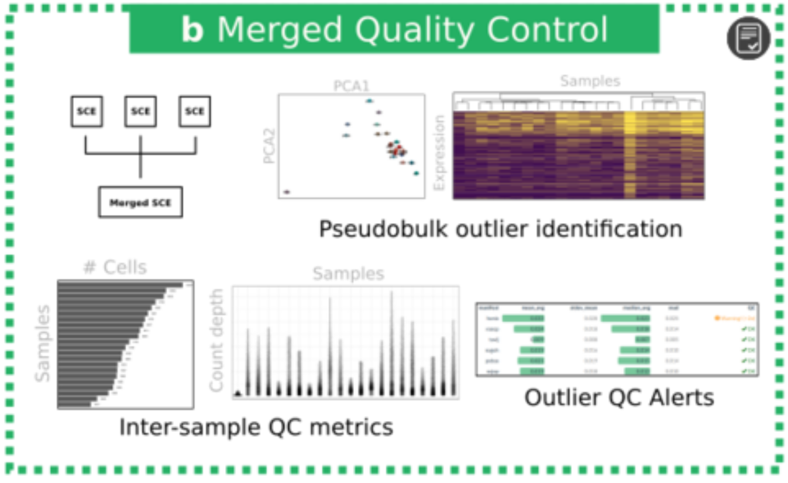
Overview of quality-control in scRNA Seq
Within sample: filter the data to include true cells which are of high-quality
Including ambient RNA profiling (emptyDrops), count/feature thresholding, and doublet/multiplet identification (DoubletFinder)
Between sample: identify problematic samples to help inform adjustment of QC parameters to salvage the sample(s) or exclude from analysis.

Slide 30
QC Report
Merged QC Report
Integration Report

Slide 31
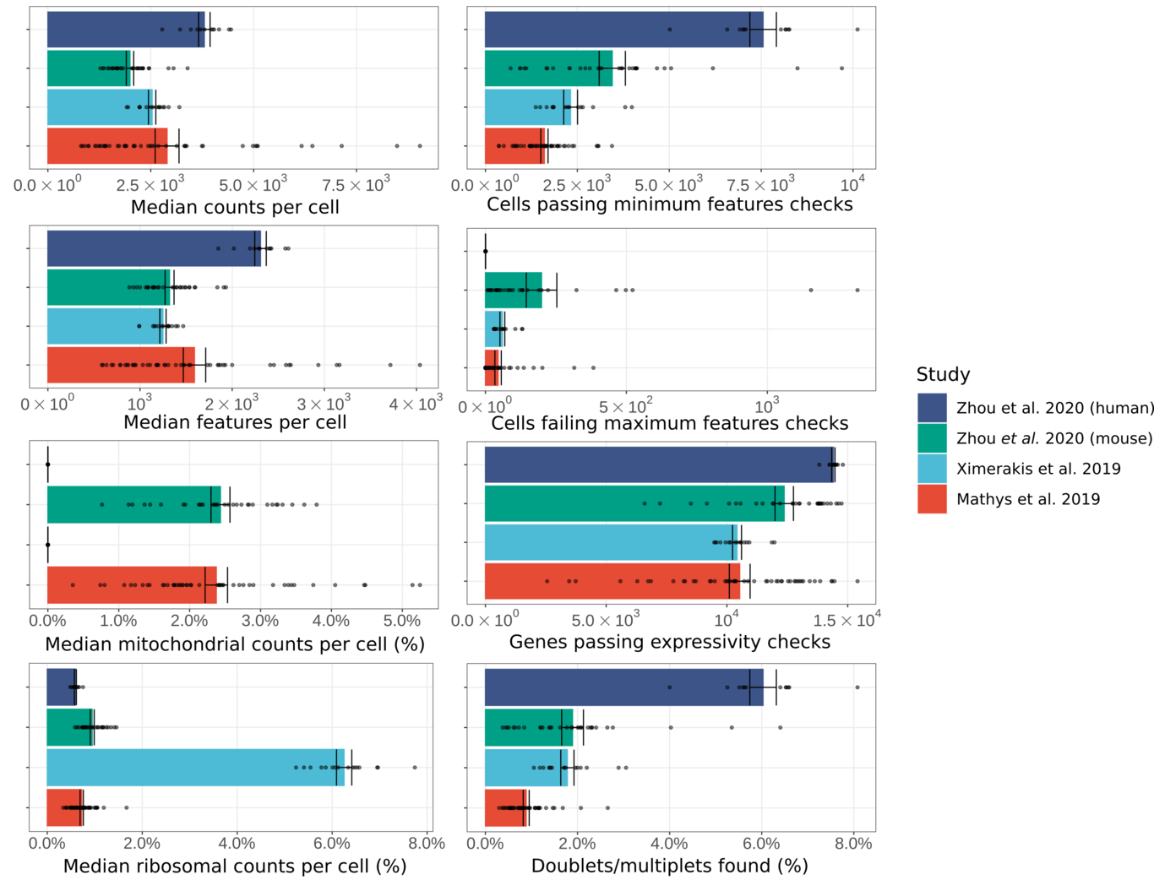
Selected quality-control metrics in 98 samples across four studies

Slide 32
Quality control references
General
Orchestrating Single-Cell Analysis with Bioconductor: https://www.nature.com/articles/s41592-019-0654-x and https://bioconductor.org/books/release/OSCA/
Current best practices in single‐cell RNA‐seq analysis: a tutorial https://doi.org/10.15252/msb.20188746
Ambient RNA Profiling
Lun et al. (2019). EmptyDrops: distinguishing cells from empty droplets in droplet-based single-cell RNA sequencing data (https://genomebiology.biomedcentral.com/articles/10.1186/s13059-019-1662-y)
Doublet Finder
McGinnis et al. (2019) DoubletFinder: Doublet Detection in Single-Cell RNA Sequencing Data Using Artificial Nearest Neighbors (https://www.cell.com/cell-systems/pdfExtended/S2405-4712(19)30073-0)
Annotation (Scater)
McGinnis et al. (2019) DoubletFinder: Doublet Detection in Single-Cell RNA Sequencing Data Using Artificial Nearest Neighbors (https://www.cell.com/cell-systems/pdfExtended/S2405-4712(19)30073-0)

Slide 33
emptyDrops
Note:
Run BEFORE any other quality-control step (e.g. thresholding)
The ‘cellranger counts’ pipeline automatically runs emptyDrops with default parameters. Typically producing a ‘raw’ and ‘filtered’ version of the gene-cell matrix as outputs.
No need to re-run emptyDrops if using the ‘filtered’ gene-cell matrix as input.
Optionally use scFlow on the ‘raw’ gene-cell matrix to provide fine control of parameters and sense checks.
Lun et al. (2019), https://doi.org/10.1186/s13059-019-1662-y

Slide 34
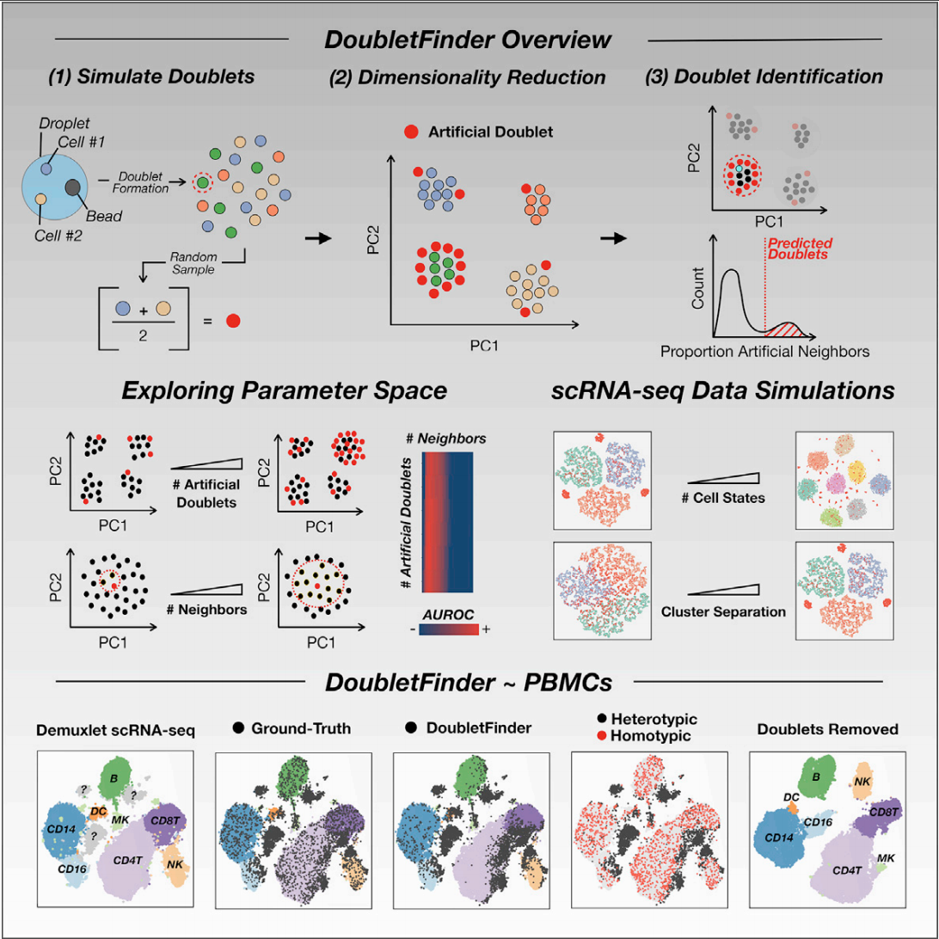
DoubletFinder
Note:
Run AFTER all other quality-control steps on a single sample.
McGinnis et al. (2019), https://doi.org/10.1016/j.cels.2019.03.003

Slide 35
Preamble to integration, dimensionality reduction, clustering, and cell-type annotation
(CK)

Slide 38
Goal →
Identify cell populations based on shared factors rather than sample-specific factors
Approach:
Identify the shared factors (integration)
Project the high dimensional data into lower dimensional space (dimensionality reduction)
Identify populations/communities of similar cells from the lower dimensional projections (clustering)
Label the communities with cell-types (cell-typing)

Slide 39
Example of clusters defined partially by sample-specific and disease-specific factors

Slide 40
Integration (CK/NF)

Slide 41
Integration
LIGER (Linked Inference of Genomic Experimental Relationships)
Why do we need to integrate data?
Data coming from different individual, batches, species and even modalities.
Welch et al., 2019

Slide 42
LIGER steps:
Dataset normalisation
Select highly variable genes
Factor selection
Quantile normalisation of the factors
The LIGER factors are then used for dimension reduction in the subsequent step.
Important parameters:
K: Integer value specifying the inner dimension of factorization, or number of factors. Higher k is recommended for datasets with more substructure. We find that a value of k in the range 20 - 40 works well for most datasets.
Lambda: This is a regularization parameter. Larger values penalize dataset-specific effects more strongly, causing the datasets to be better aligned, but possibly at the cost of higher reconstruction error. The default value is 5.

Slide 43
Dimensionality Reduction (CK)

Slide 44
Why perform dimensionality reduction?
Even assuming all variables (genes) are relevant, the dimensionality of the data can be larger than necessary.
e.g. some genes may be highly correlated and we can remove redundancy in the data
The most relevant data can be emphasised (remove noise)
Simplifying the complexity of the data can reduce computational requirements (e.g. clustering)
Data visualization (it’s difficult to visualize data beyond 2D/3D)
20D → 2D

Slide 45
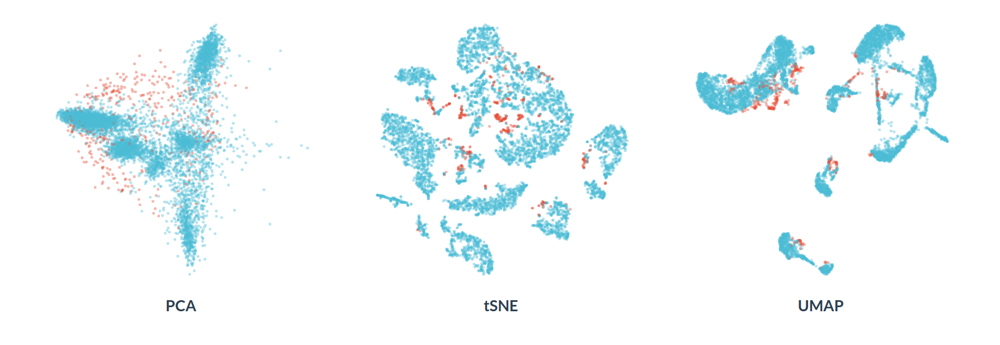
Dimensionality reduction algorithms
There are a wide range of algorithms for dimensionality reduction. The most common you will see for single-cell RNAseq are:
PCA (linear, matrix factorization)
t-SNE (non-linear, graph-based)
UMAP (non-linear, graph-based)

Slide 46
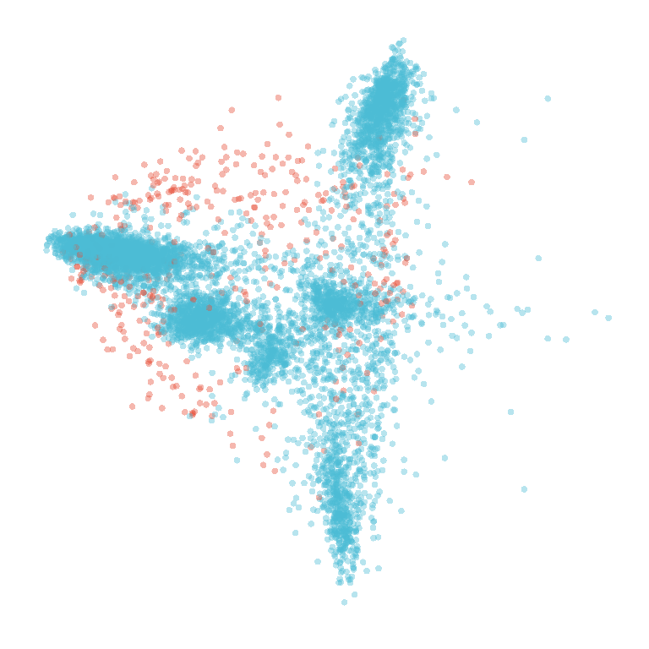
Issues with PCA for 2D single-cell projections
PCs 1, 2, and 3 frequently correlate with sequencing depth / number of genes switched on

Slide 47
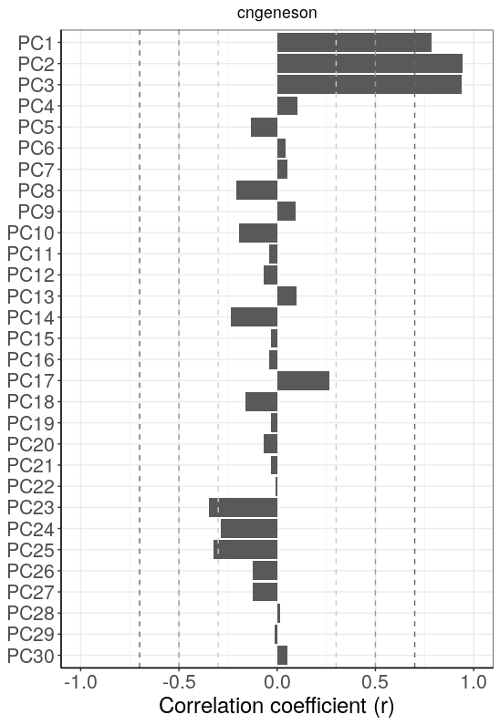
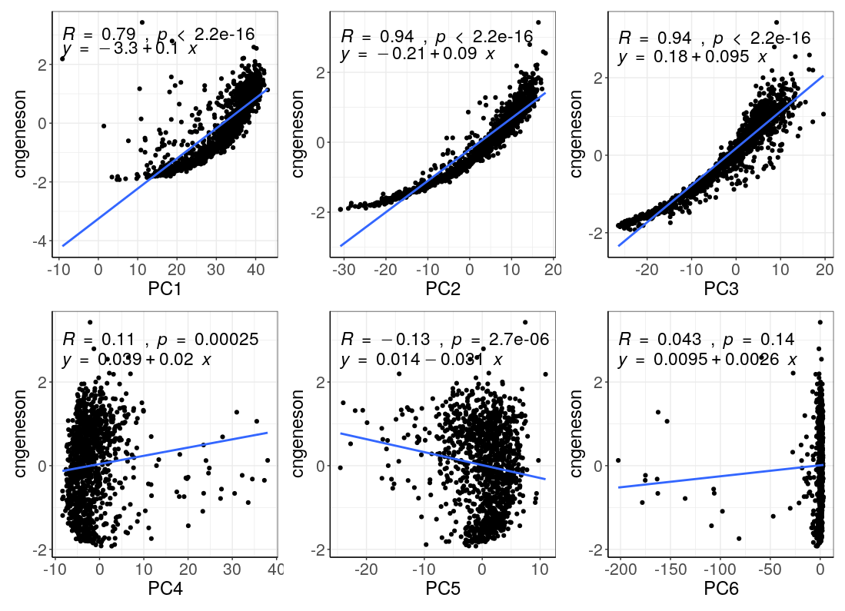
Example: cellular detection rate correlation with PCs 1,2,3

Slide 48
Issues with PCA for 2D single-cell projections
Linear method doesn’t capture complex dependencies
PCs 1, 2, and 3 frequently correlate with sequencing depth / number of genes switched on
Performs poorly at separating cells with 0-inflated expression data (non-linearity)
However, PCs are interpretable and we can filter/select the top n (e.g. 30) PCs or those explaining at least 1% of variance, etc.
We can also initialize non-linear dimensionality reduction algorithms (e.g. tSNE, UMAP) with the top PCs as inputs.

Slide 49
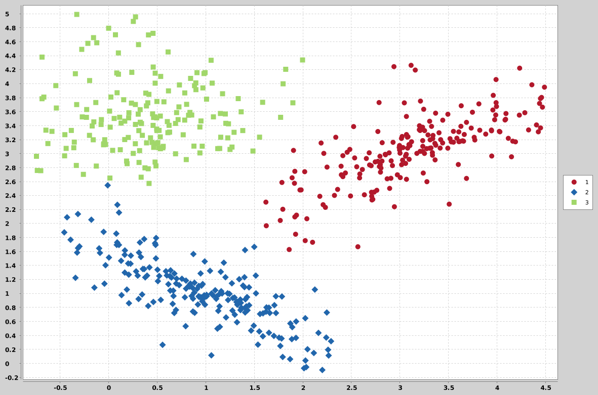
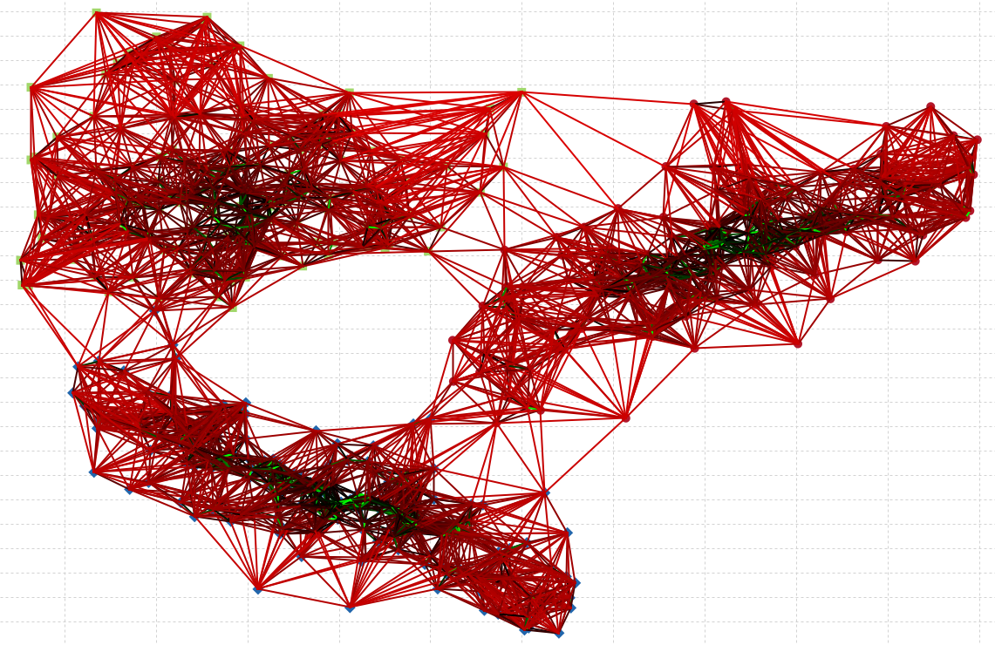
t-distributed stochastic neighbor embedding (t-SNE)
A graph-based non-linear dimensionality reduction method
Two steps:
Construct a weighted graph based on the top k-connections (k-nearest neighbours graph)
Each dot is a cell, each line represents a connection between two cells.
Compute and optimise the low dimensional layout of the graph

Slide 50
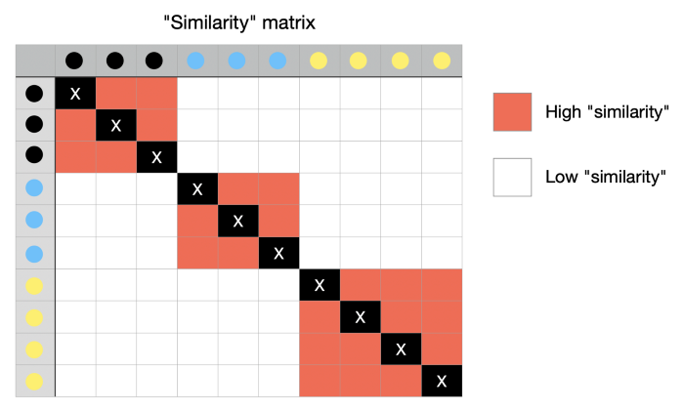
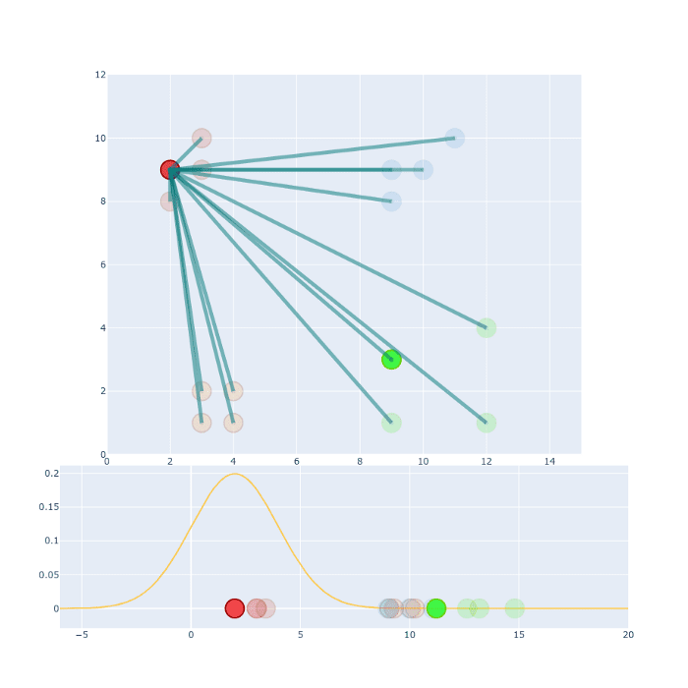
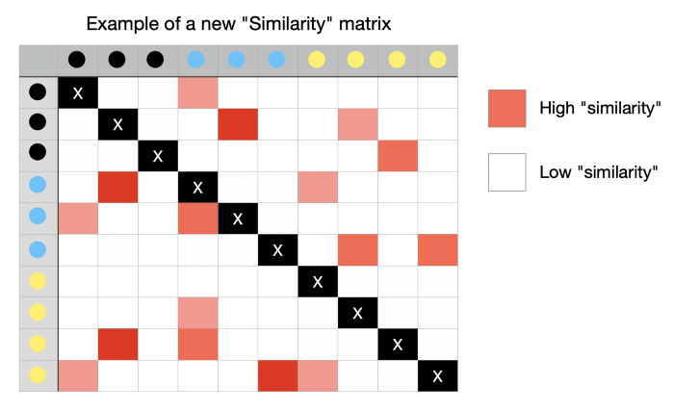
p_{j|i} and q_{j|i} measure the conditional probability that point i would pick point j as it’s nearest neighbour in high (p) and low (q) dimensionality reduction space, respectively
i
p_{j|i}
j
q_{j|i}
Iteratively move points in lower dimensional space until the similarity matrix resembles that seen in higher dimensional space

Slide 51
tSNE hyper-parameters
There are a range of hyper-parameters for t-SNE; however, the most common hyperparameters to tune are: perplexity, number of iterations, learning rate.

Slide 52
tSNE notes
A non-linear dimensionality reduction method
Stochastic – does not learn an explicit function and no ‘optimal t-SNE’ can be computed
Hyper-parameters are dataset specific
The local structure is preserved over global structure

Slide 53
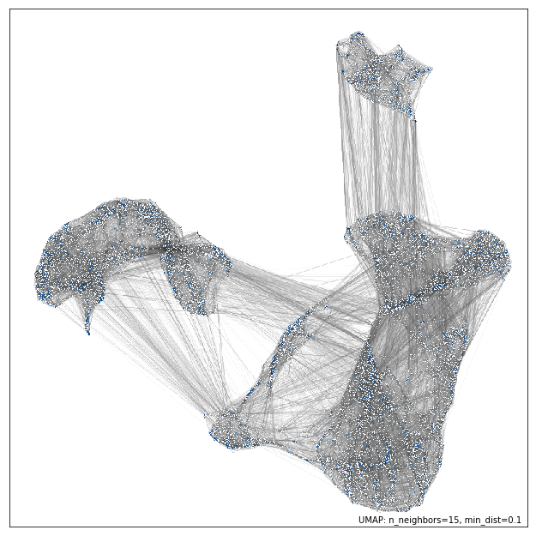
Uniform Manifold Approximation and Projection (UMAP)
Also a non-linear graph based dimensionality reduction method
Nodes (cells) are connected with a line (edge) if the distance between them is below a threshold
Relative point distances are calculated based on topological structures (simplices), rather than randomly initiated as in tSNE)
McInnes 2019 | https://umap-learn.readthedocs.io/en/latest/index.html

Slide 54
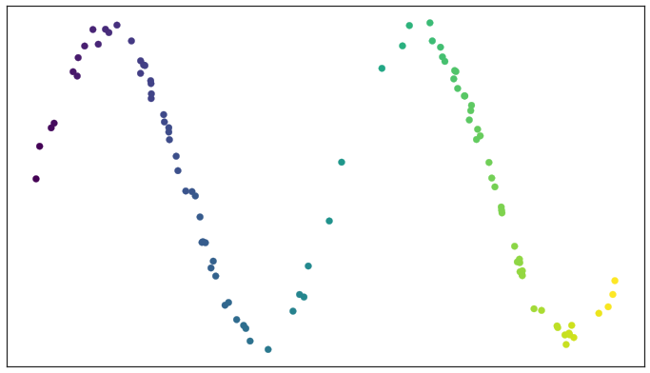
Example data (noisy sine wave)

Slide 55
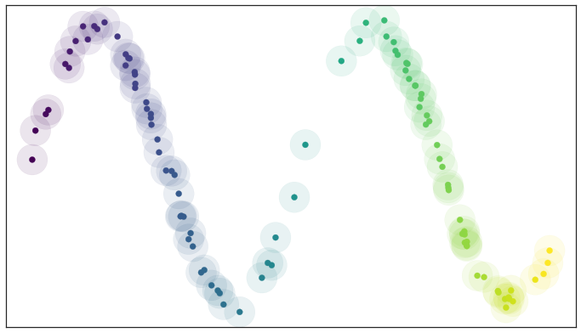
Example data (noisy sine wave)

Slide 56
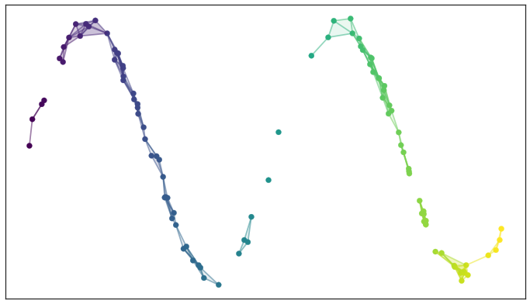
Example data (noisy sine wave)

Slide 57
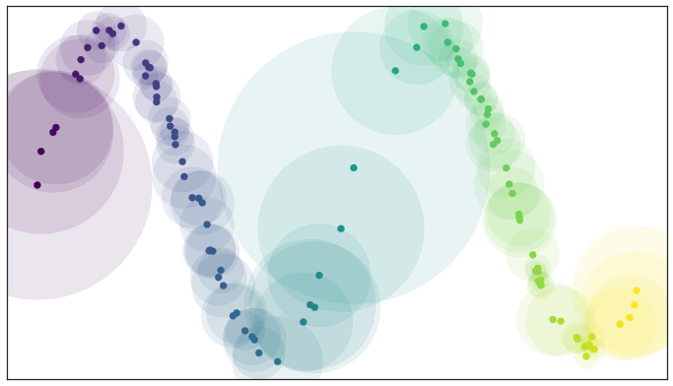
Example data (noisy sine wave)

Slide 58
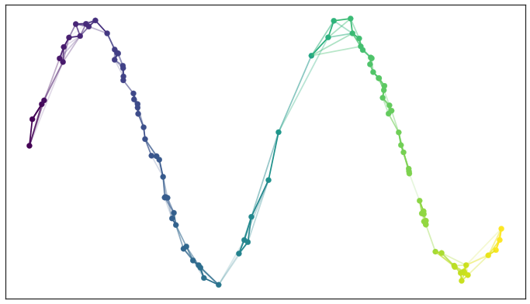
Example data (noisy sine wave)
Connected the entire dataset, capturing both the global and local structure of the data

Slide 59
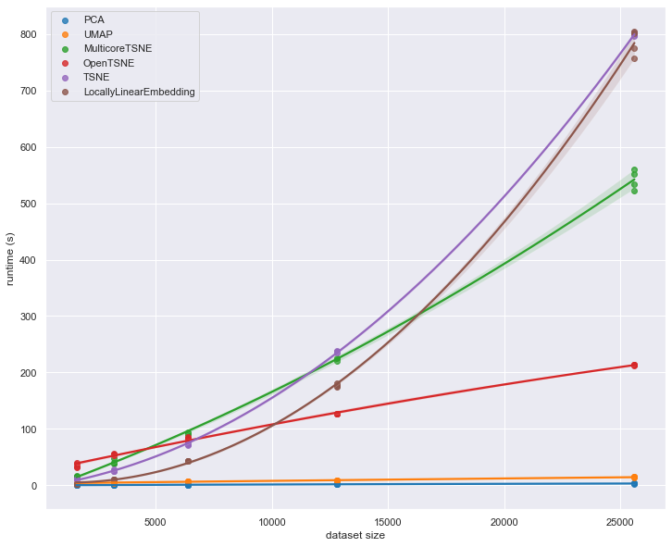
UMAP is computationally efficient
UMAP scales well with larger datasets
Runtimes are generally faster for UMAP vs t-SNE

Slide 60
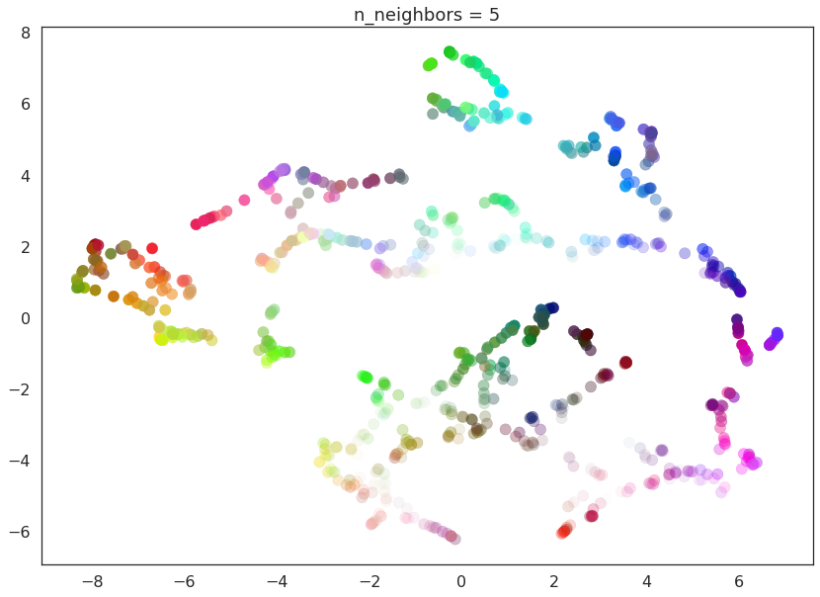
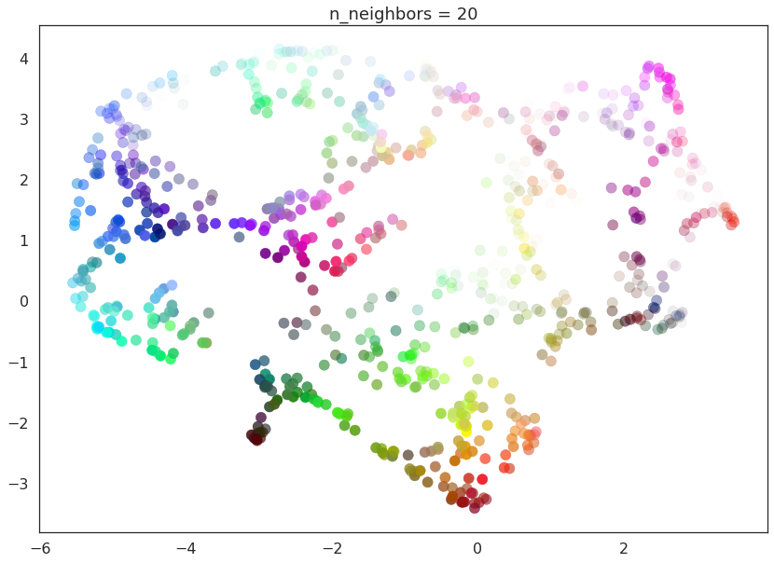
UMAP hyper-parameters
There are a range of UMAP hyper-parameters but the most commonly tuned are: n_neighbours, min_dist, n_components, and metric.

Slide 61
UMAP summary
A non-linear graph-based dimensionality reduction method
Not completely stochastic as in t-SNE
Emphasises both local and global distances
Computationally efficient

Slide 62
Clustering and cell-typing

Slide 63
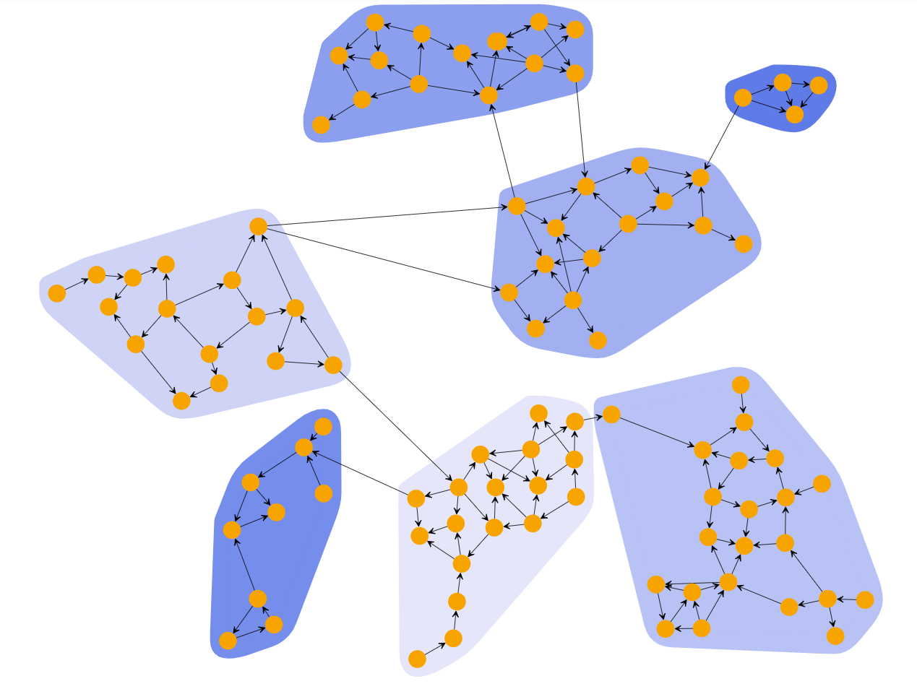
Graph clustering (community detection)
Communities (clusters) are groups of nodes (cells) with higher probability of being connected to each other than to members of other groups
Community detection: find a community of nodes (cells) with more edges within the group than edges linking nodes of the community with the rest of the graph
There are a wide range of algorithms available to optimize the problem of how to optimally cut edges in graphs
Some clustering algorithms are not graph-based, but today we are using the popular Leiden community detection algorithm.

Slide 64
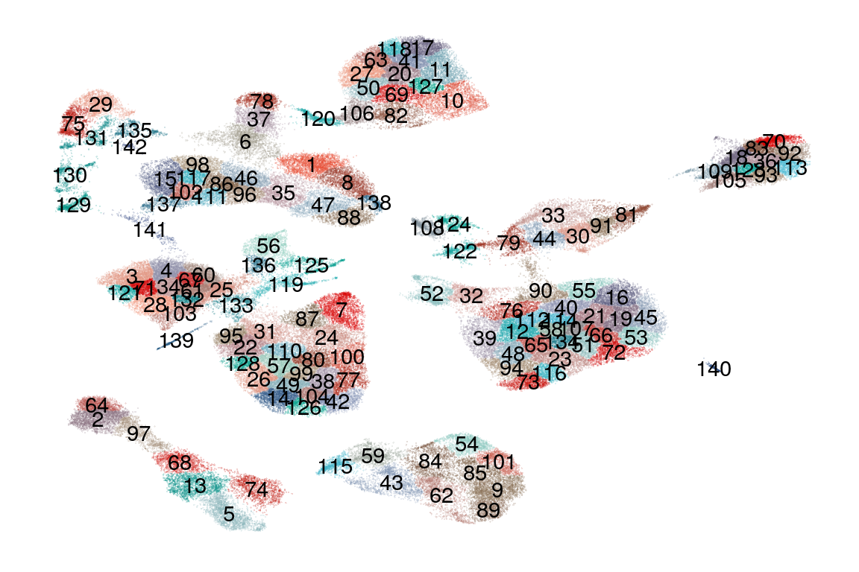
Clustering is subjective
The granularity of clustering can be tuned using parameters.
You can always split a cluster into sub-clusters.
Evaluate cluster identity using marker genes and distances in UMAP/tSNE embeddings.

Slide 65
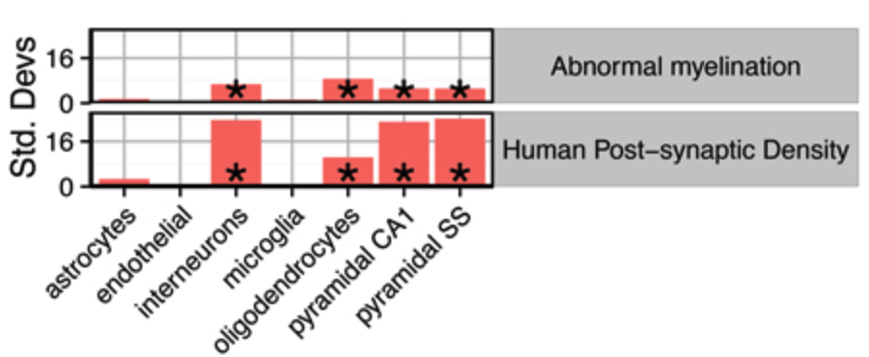
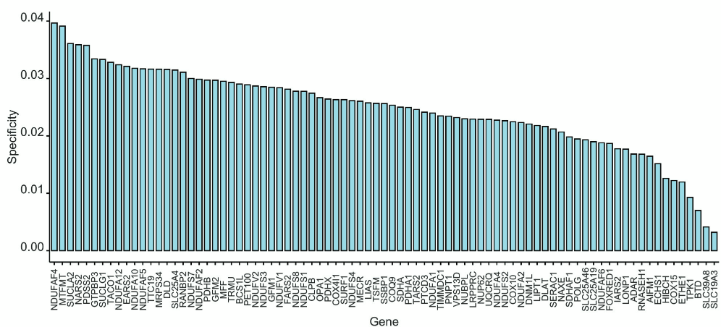
Cell-typing with EWCE
EWCE¹ tests specificity of gene lists in cell types based on a reference dataset
Tests gene list against many permutations of random background gene lists
Identification of Vulnerable Cell Types in Major Brain Disorders Using Single Cell Transcriptomes and Expression Weighted Cell Type Enrichment Front. Neurosci., 27 January 2016 Sec. Neurogenomics https://doi.org/10.3389/fnins.2016.00016
Notes:
Specificity - the average expression for cells in a cell type (like mean pseudobulk essentially) is calculated. Then EWCE gets the normalised expression of the gene for each cell type and then calculates the specificity by dividing by the total normalised expression of that gene.

Slide 66
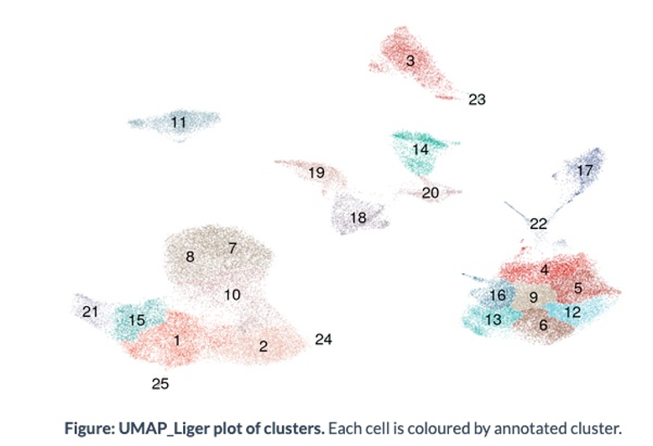
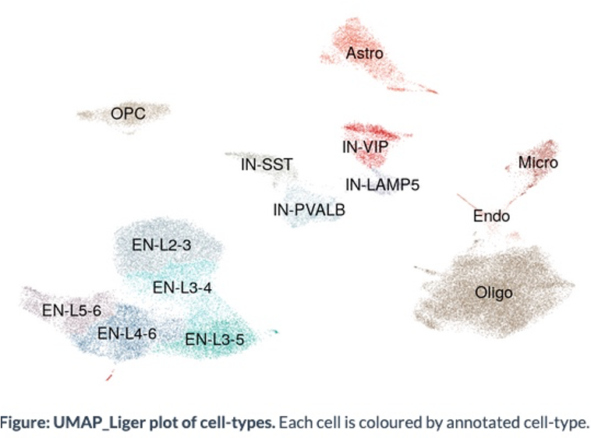
Cell-typing with EWCE
Reference dataset (Allen human brain atlas¹)
Marker genes - top 10% specific genes per cell type
EWCE uses markers as gene list
Tests markers against background gene lists to identify cell types

Slide 67
Differential Gene Expression, Impacted Pathway Analysis & Dirichlet Modeling

Slide 69
Differential gene expression

Slide 70
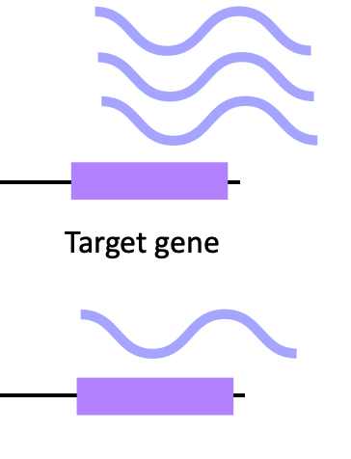
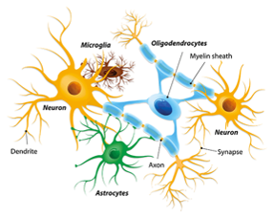
DGE - The What & Why
Signor, Sarah A.; Nuzhdin, Sergey V. (2018). The Evolution of Gene Expression in cis and trans. Trends in Genetics, (), S0168952518300623–. doi:10.1016/j.tig.2018.03.007
Notes:
what DGE is and what sort of questions it is used to ask/answer. Eg. differences in expression across experimental or disease populations , or (sub)types of cells(?)

Slide 71
DGE - Single Cell vs Bulk
Bulk - Changes in mRNA confounded by:
Different responses across cell types
Different cell type compositions¹
Single-cell:
Sparsity
Intra-individual variance
Inter-individual variance
Squair, J.W., Gautier, M., Kathe, C. et al. Confronting false discoveries in single-cell differential expression. Nat Commun 12, 5692 (2021). https://doi.org/10.1038/s41467-021-25960-2

Slide 72
DGE - Approach
Potential confounds¹:
Use measured data (raw counts)
Include technical covariates
Remove lowly expressed genes (1 count in 10% of cells)
Correct for multiple testing
Different approaches:
MAST
Pseudobulk
Current best practices in single-cell RNA-seq analysis: a tutorial Malte D Luecken, Fabian J Theis Mol Syst Biol. (2019) 15: e8746https://doi.org/10.15252/msb.20188746

Slide 73
DGE - Approach
Potential confounds¹:
Use measured data (raw counts)
Include technical covariates
Remove lowly expressed genes (1 count in 10% of cells)
Correct for multiple testing
Different approaches:
MAST - two-part GLM
Pseudobulk - GLM (EdgeR LRT)
Current best practices in single-cell RNA-seq analysis: a tutorial Malte D Luecken, Fabian J Theis Mol Syst Biol. (2019) 15: e8746https://doi.org/10.15252/msb.20188746
Notes:
MAST - two-part generalised linear model (discrete logistic regression component for expression rate and a continuous Gaussian component conditioned on each cell expressing a gene)
EdgeR - Negative binomial model

Slide 74
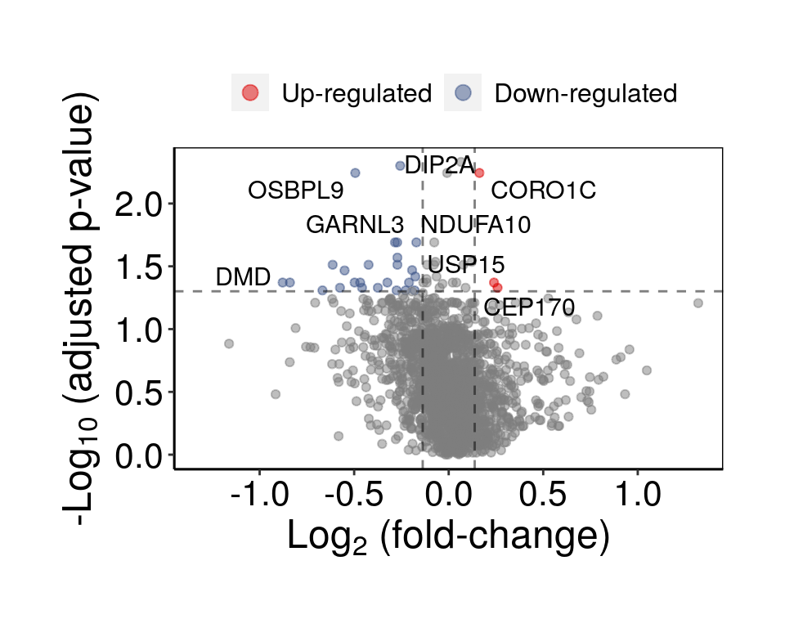
DGE - scFlow Results

Slide 75
Impacted Pathway Analysis

Slide 76
Impacted Pathway Analysis
“Pathway analysis is a set of widely used tools for research in life sciences intended to give meaning to high-throughput biological data.”
-Garcia-Campos et al., 2015
Gene
Protein
Lipid
Metabolite
Luecken et al., 2019

Slide 77
Impacted Pathway Analysis
Input list
Database

Slide 78
Impacted Pathway Analysis
Types of enrichment analysis
-self contained: enrichR
-competitive: webgestaltR
Kao et al., 2016

Slide 79
Compositional analysis using dirichlet modeling
-The proportional dependency within a sample is taken into account
Luecken et al., 2019

Slide 80
HPC, Private Cloud and NextFlow

Slide 81
Imperial UKDRI Private Cloud
Collaborating with Data Sciences Institute we are using OpenStack to provide everyone access to bespoke virtual workstations, with large amounts of RAM and CPU availability.
Optimal resource usage, low admin and rapid expandability.
Imperial authentication via Kerberos
Virtual workstations are requested/provided through group leaders.
Complementary to HPC - good for small-medium sized analyses and long-term data/analysis exploration. Ability to install any software, set up web servers etc.

